Slide 1

Web Development Foundations
06
Asynchronous Javascript

Slide 2
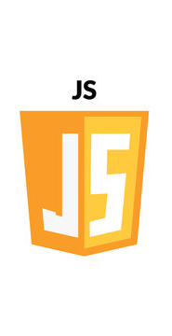
Part 1: Recap & Assessment Review
The DOM: We learned that HTML is a "Tree" (DOM) that JavaScript can climb, edit, and prune.
Events: We moved from static code to "Reactive" code using addEventListener.
Data-to-UI: We practiced the most important pattern in modern web dev: Data (Array) ➔ Loop ➔ Template Literal ➔ UI.
State: We used localStorage to give our browser a "memory."

Slide 3
Assessment #2
Review
Notes:
Part 1: Assessment & Review (40 Minutes)
MCQ #1 (20m): Conduct the first graded Knowledge Check (covering HTML Semantics and Accessibility).
Assignment Review (20m): Review common pitfalls from the "Hello World" enhancements.
Common Bug: Forgetting to link the CSS file in the <head>.
Common Bug: Labels not properly linked to Input IDs.

Slide 4
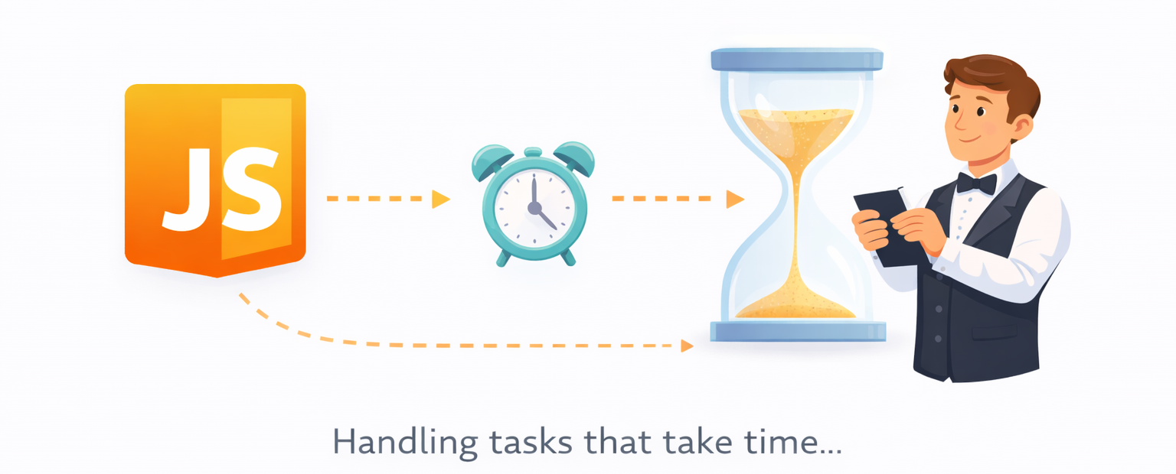
Part 2: Asynchronous JavaScript

Slide 5
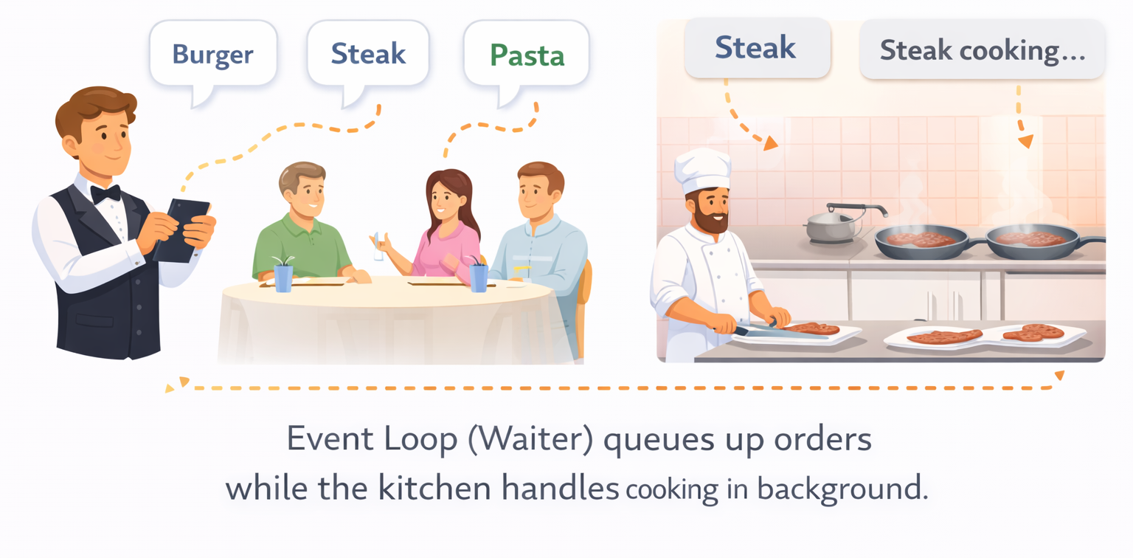
Introduction to Asynchrony
Synchronous vs. Asynchronous: Why we can't let a slow data request "freeze" the browser.
The Event Loop: How JS handles tasks in the background.
Promises: The concept of a "Pending," "Resolved," or "Rejected" result.
https://www.w3schools.com/js/js_asynchronous.asp

Slide 6
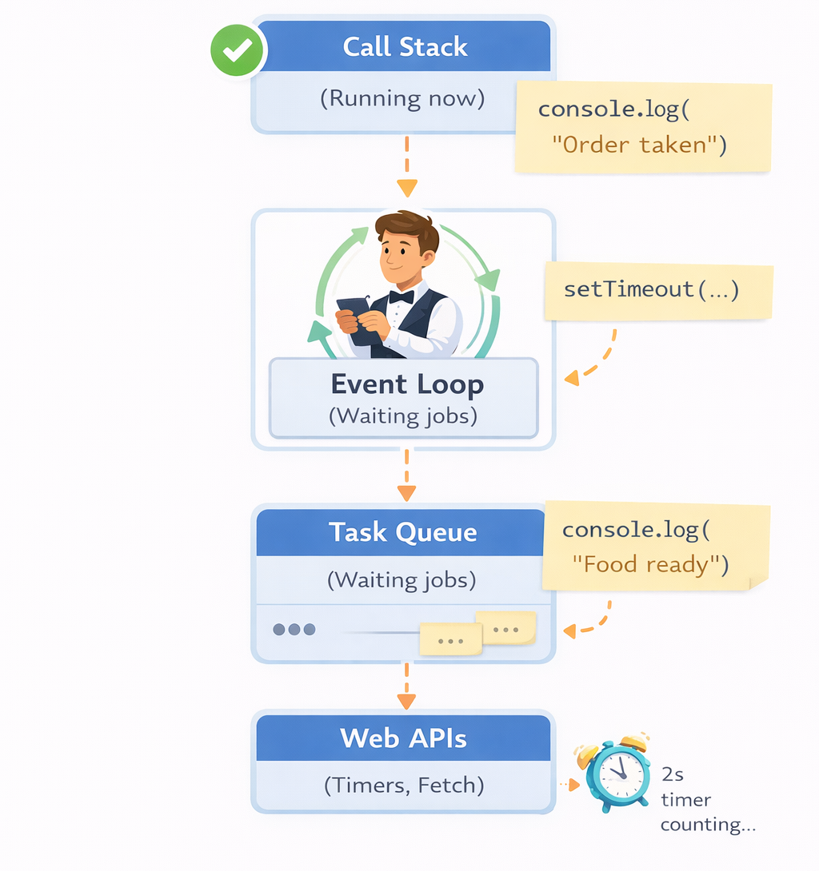
JavaScript Event Loop
JavaScript is single threaded.
Allows JavaScript to handle many tasks without getting stuck.
The event Loop keeps checking if the call stack is empty. If it is, moves the next task from the Task Queue to the stack and runs it.

Slide 7
The fetch API
Topic: Talking to the Cloud
What is fetch API? - It provides a JavaScript interface for making HTTP requests and processing the responses.
The fetch() Syntax:
fetch(url)
.then(response => response.json())
.then(data => { ... })

Slide 8
JSON
JSON stands for JavaScript Object Notation.
It is a lightweight format for storing and transporting information, commonly used between servers and clients.
Examples:
JSON Data (Name/Value Pair) | "firstName":"John"
JSON Object | { "firstName":"John", "lastName":"Doe" }
JSON Array | "employees":[ {"firstName":"John", "lastName":"Doe"}, {"firstName":"Anna", "lastName":"Smith"}, {"firstName":"Peter", "lastName":"Jones"} ]
Rules
Data is in name/value pairs
Data is separated by commas
Curly braces hold objects
Square brackets hold arrays

Slide 9
Live Demo
Load Student data
https://codepen.io/magnetik-works/pen/dPXWrYW
Notes:
https://codepen.io/magnetik-works/pen/dPXWrYW?editors=1111

Slide 10
10
Minute Break

Slide 11
Part 3: Modern Syntax
Topic: Async/Await & Dynamic Fetching
Async/Await: Making asynchronous code look and behave like synchronous code (easier to read).
Try/Catch: Handling errors gracefully (e.g., if the internet is down).

Slide 12
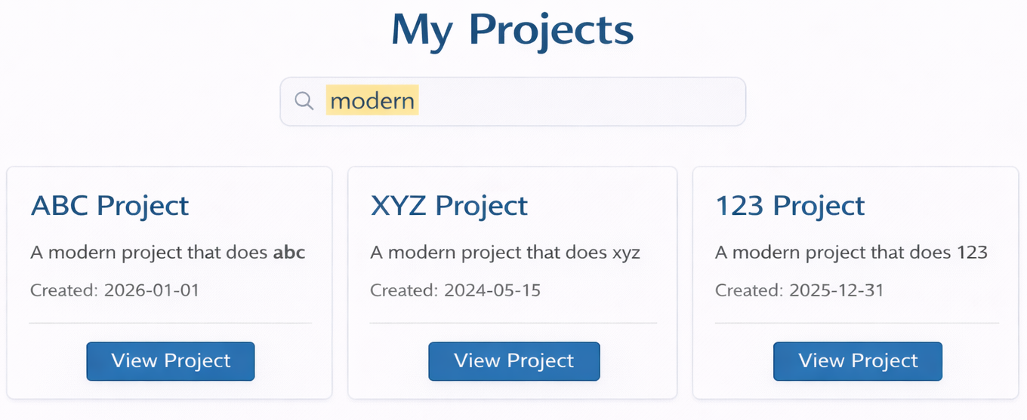
Hands on Lab
Update the Dynamic Data Assignment to remove the myProjects hardcoding and instead load them from an API using fetch API.
Use following endpoint to get the project details:
https://magnetikworks.github.io/project-data/data/projects.json

Slide 13
Summary
1. Async JS
Asynchronous JS allows your page to stay responsive while waiting for data.
2. Promises & States
A Promise is a placeholder for a future value. It is either Resolved (success) or Rejected (error).
3. Fetch is the Standard
fetch() is the modern browser API for making network requests. It always returns a Promise.
4. Async/Await is the Goal
Use async and await for cleaner, more readable code. Always wrap them in try/catch to handle network failures.

